Slide 1
IEEE 10th International Conference on Emerging Trends in Engineering & Technology Signal and Information Processing (ICETET-SIP-22)
29-30 April, 2022, Nagpur, INDIA
Go-Brainous: An AI Based Educational App for Kids
( Paper ID 1574 )
Presented by Bhimraj Parihar
Department of Information Technology
P. Shah Institute of Technology
Thane(w), Mumbai-400615
Organized by G H RAISONI COLLEGE OF ENGINEERING, Nagpur, Maharashtra, INDIA

Slide 2
Introduction
Over the past several decades, technology has had a significant impact on children. Because it may shape their lives, children require a strong educational foundation, which can be conveniently delivered through technology. The newest trend in children's education is game-based learning and their academic performance will improve and they will gain from it.
Problem Identified :
In today’s world it is seen that students are more into technology than focusing on their studies. They are always on their mobile phones to play games which will divert kid’s from studies.
Solution Proposed :
Thiss project is about an educational gaming app through which students develop a variety of connections with the content and can form positive memories of learning as games grab students attention and actively engage them.
IEEE 10th International Conference on Emerging Trend
in Engineering & Technology Signal and Information Processing (ICETET-SIP-22), GHRCE Nagpur, INDIA

Slide 3
Literature Review
Serial No. | Paper Name | Author Name | Key Findings
1. | A Study of Early Childhood E-Learning Games for Thai Children | Veeraporn Siddoo, Dainah Binla, Kanokwan Jaineawnaekuson, Orapan Yommana | This paper presents a prototype for e-learning games as well as the appropriate e-learning games for preschoolers. The discovery creates an alternative to learning games by examining professional advice given during game development.
2. | A Custom and Dynamic Game using Gamification Techniques to Children from 4 to 5 years old. | Renato Toasa, Esteban Burbano, Alexandra Constante, Lesly Hidalgo, Flavio Morales | The concept for developing various mobile games that could help children in learning the alphabet, numbers, and other subjects in the early stages of their education is described in this paper.
IEEE 10th International Conference on Emerging Trend
in Engineering & Technology Signal and Information Processing (ICETET-SIP-22), GHRCE Nagpur, INDIA

Slide 4
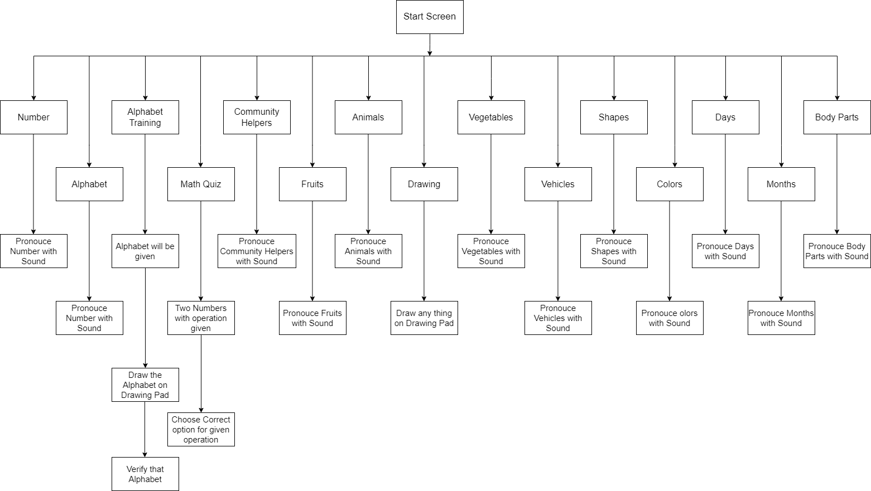
Methodology
IEEE 10th International Conference on Emerging Trend
in Engineering & Technology Signal and Information Processing (ICETET-SIP-22), GHRCE Nagpur, INDIA

Slide 5
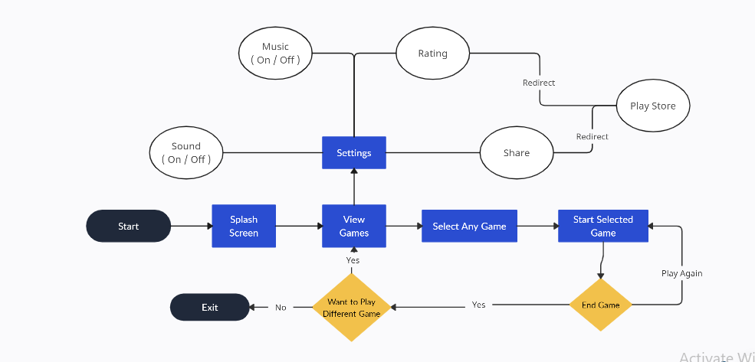
Methodology
IEEE 10th International Conference on Emerging Trend
in Engineering & Technology Signal and Information Processing (ICETET-SIP-22), GHRCE Nagpur, INDIA

Slide 6
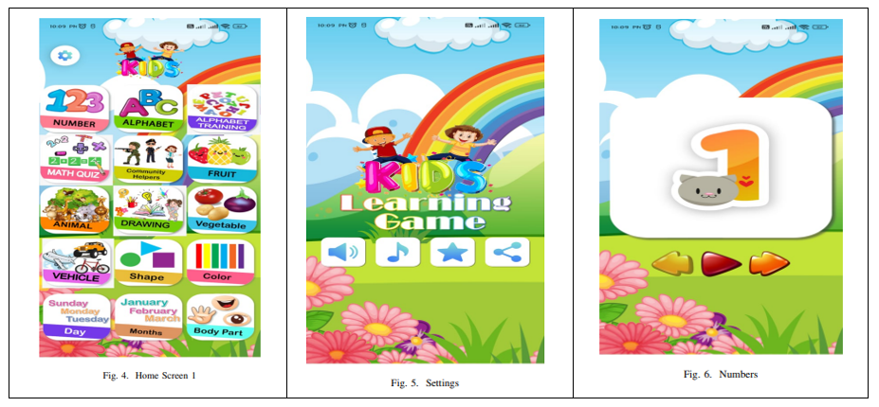
Results and Discussion
IEEE 10th International Conference on Emerging Trend
in Engineering & Technology Signal and Information Processing (ICETET-SIP-22), GHRCE Nagpur, INDIA

Slide 7
Results and Discussion
After extensive development and testing, the Go-Brainous app has been successfully created, providing a fun and engaging way for kids to learn and improve their cognitive skills. The app includes various quizzes, games and creative activities such as numbering, alphabet, alphabet training, math quiz, fruits, animals, vegetables, drawing books, vehicles, shapes, colours, days, months and body parts.
The use of the TensorFlow Lite model has enabled the app to provide accurate and reliable performance while maintaining optimal speed and responsiveness. The Java and XML platform used in its development has ensured a user friendly interface and easy navigation for kids. The feedback received from users during the testing phase has been overwhelmingly positive, with many expressing satisfaction with the app’s design, content, and effectiveness. Overall, the Go-Brainous app has met its objective of providing an enjoyable and effective educational tool for kids, promoting a positive attitude towards learning and mental development.
IEEE 10th International Conference on Emerging Trend
in Engineering & Technology Signal and Information Processing (ICETET-SIP-22), GHRCE Nagpur, INDIA

Slide 8
Conclusions
The Go-Brainous game has been developed for kids in which quizzes and games are included like numbering, alphabet, alphabet training, math quiz, fruits, animals, vegetables, drawing books, vehicles, shapes, colours, days, months and body parts. The app has developed using the TensorFlow lite Model. The proposed system is developed on Java and XML where XML use for creating a layout. The Go-Brainous has provided an easy and interesting way of learning for kids. This project is successfully became an educational app through which students develop a variety of connections with the content and can form positive memories of learning as games to grab the students’ attention and actively engage them.
IEEE 10th International Conference on Emerging Trend
in Engineering & Technology Signal and Information Processing (ICETET-SIP-22), GHRCE Nagpur, INDIA

Slide 9
Bibliography / References
V. Siddoo, D. Binla, K. Jaineawnaekuson and O. Yommana, ”A study of early childhood elearning games for Thai children,” 2016 Fifth ICT International Student Project Conference (ICT-ISPC), 2016, pp. 29-32, doi: 10.1109/ICT-ISPC.2016.7519228.
A. A. Yunanto, D. Herumurti, I. Kuswadayan, R. R. Hariadi and S. Rochimah, ”Design and Implementation of Educational Game to Improve Arithmetic Abilities for Children,” 2019 12th International Conference on Information Communication Technology and System (ICTS), 2019, pp. 27-31, doi: 10.1109/ICTS.2019.8850966.
R. Toasa, E. Burbano, A. Constante, L. Hidalgo and F. Morales, ”A Custom and Dynamic Game using Gamification Techniques to Children from 4 to 5 years old,” 2019 14th Iberian Conference on Information Systems and Technologies (CISTI), 2019, pp. 1-5, doi: 10.23919/CISTI.2019.8760593.
A. Dinimaharawati, A. I. Wuryandari and H. A. Aziiz, ”Designing Educational Games on E-learning SMANAS Based Learning Experience Design,” 2018 International Seminar on Research of Information Technology and Intelligent Systems (ISRITI), 2018, pp. 265-270, doi: 10.1109/ISRITI.2018.8864470.
H. B. Ram´ırez Moreno, M. R. Ram´ırez, E. M. Rojas and M. del Consuelo Salgado Soto, ” Digital education using apps for today’s children,” 2018 13th Iberian Conference on Information Systems and Technologies (CISTI), 2018, pp. 1-6, doi: 10.23919/CISTI.2018.8399329.
IEEE 10th International Conference on Emerging Trend
in Engineering & Technology Signal and Information Processing (ICETET-SIP-22), GHRCE Nagpur, INDIA

